Slide 1
Voice recognition using neural network
AI Project II
Final Presentation
201401210 Hyeongwon Kang
Submission Date: December 12th,2018
Professor: Sung Mee Young Prof.

Slide 2
Contents
01. Introduction
02. Project overview
03. Process
04. Result

Slide 3
1
Introduction
Voice recognition, Target

Slide 4
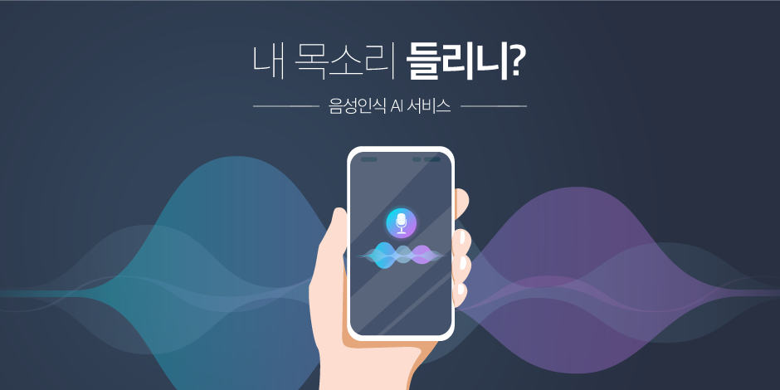
Voice recognition
Source) http://blog.cheil.com/33014

Slide 5




Target
안녕하세요.
강형원님
안녕

Slide 6
2
Project overview
Method, Data, Hard/Soft ware, Technology

Slide 7
Method
1
Collect voice data
2
Adjust voice data and secure data
3
Data preprocessing
4
Data training on neural network
5
Voice recognition
6
Result

Slide 8

Data
REC
Using about 6 voice data
Record three times
By adjusting the time and height of the voice file
Securing the Number of Data

Slide 9



Hardware & Software
or
Input voice data and output result
Data training & voice recognition

Slide 10
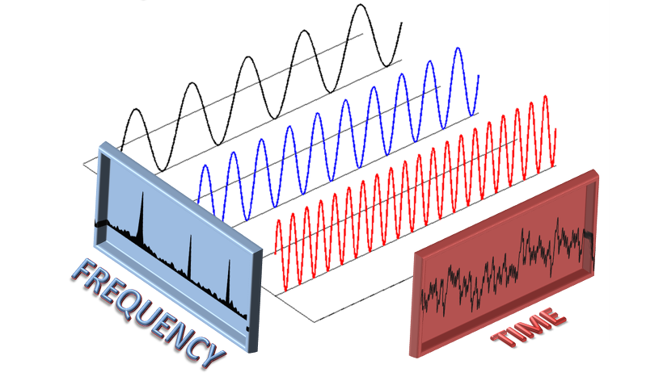
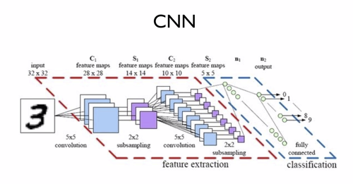
Technology
1
Fourier transform (FFT)
2
Tensorflow
Arduino library:ArduinoFFT3
Using CNN

Slide 11



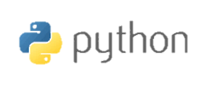


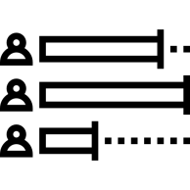

Technology
FFT
serial

Slide 12
3
process
Collect data, Edit data, Train data, Test, Setting

Slide 13
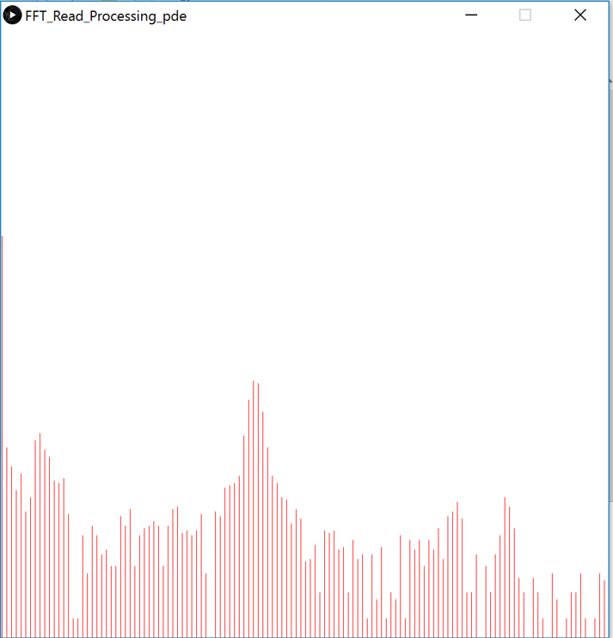
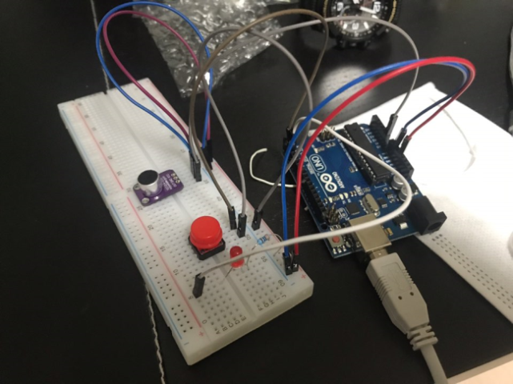
Collect Data
1
Sound data collection using Arduino microphone module
FFT

Slide 14
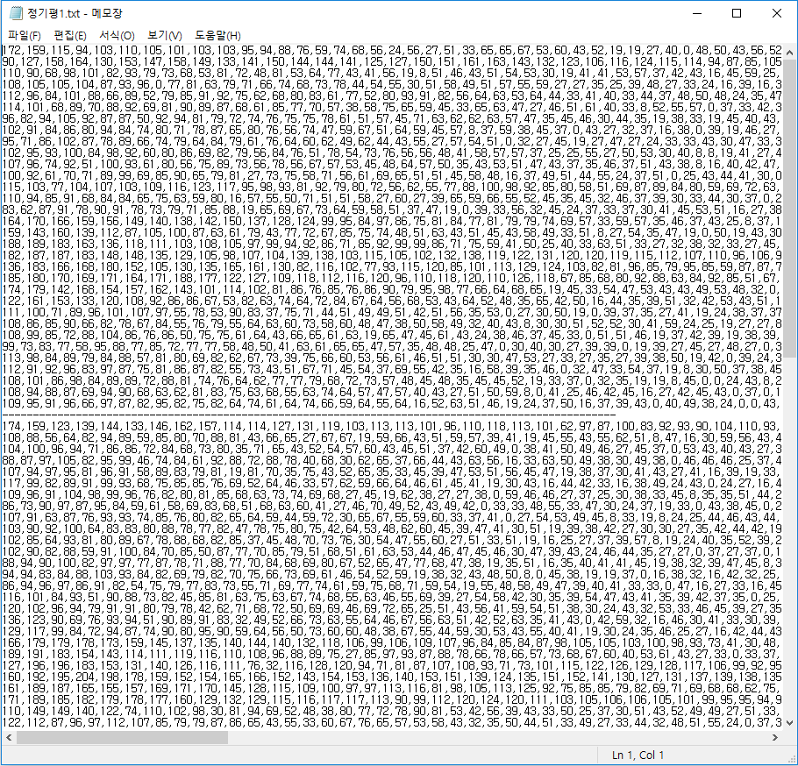
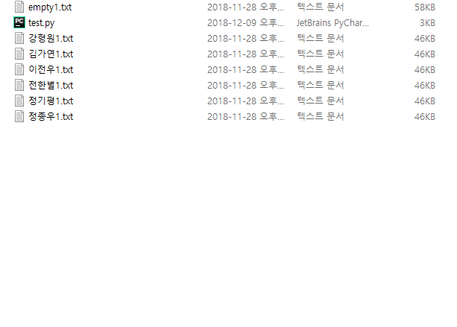
Collect Data
1
Sound data collection using Arduino microphone module

Slide 15
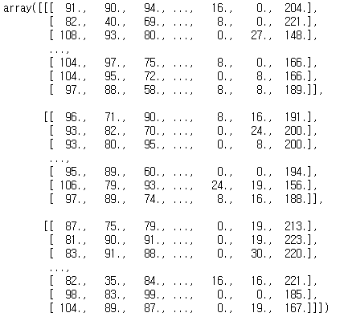
Edit data
1
Modifying data

Slide 16
Edit data
1
Modifying data
Original data
Original data – Noise data
Adjusting the height
Adjusting the time
Adjusting the time
height+Noise data
time+Noise data
height+time+Noise data

Slide 17
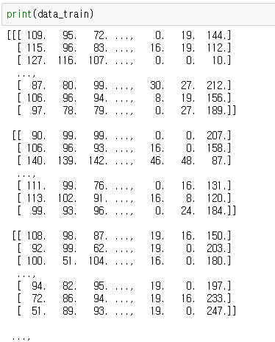
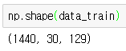
Edit data
1
Modifying data

Slide 18
Train data
1
CNN
91 | 90 | 94 | ··· | 16 | 0 | 204
82 | 40 | 69 | ··· | 8 | 0 | 221
108 | 93 | 80 | ··· | 0 | 27 | 148
··· | ··· | ··· | ··· | ··· | ··· | ···
104 | 97 | 75 | ··· | 8 | 0 | 166
104 | 95 | 72 | ··· | 0 | 8 | 166
97 | 88 | 58 | ··· | 8 | 8 | 189
It is similar to an image.

Slide 19
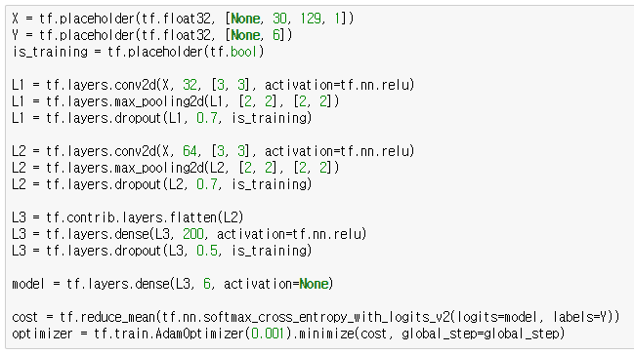
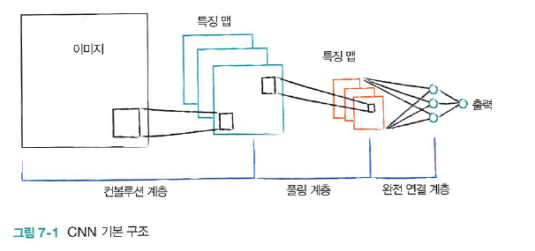
Train data
1
CNN

Slide 20
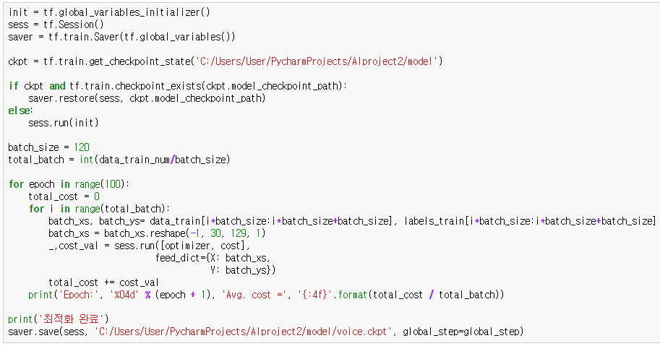
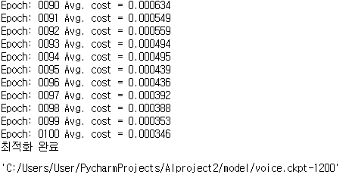
Train data
1
CNN

Slide 21
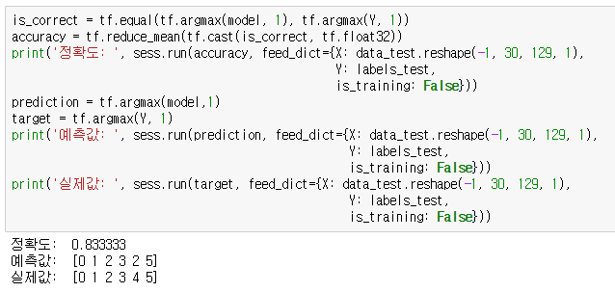
Test
1
Test with test data

Slide 22
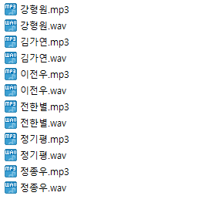

Setting
1
audio file (used Google TTS)

Slide 23
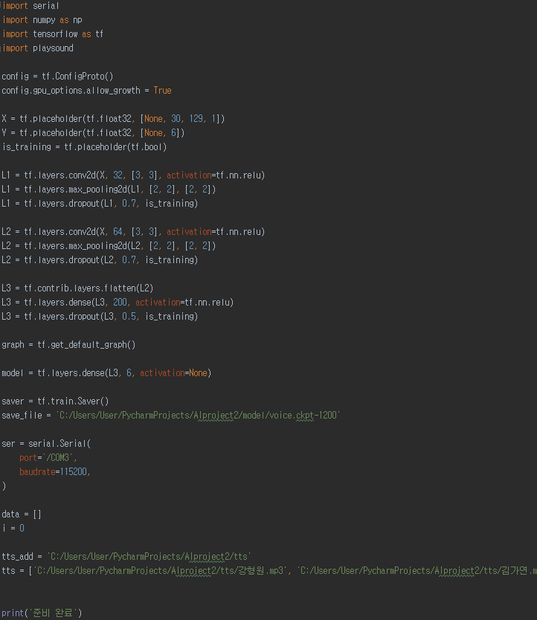
Setting
2
code

Slide 24
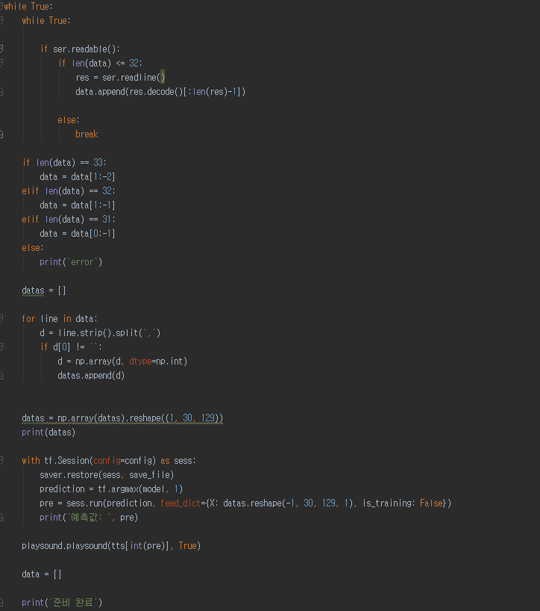
Setting
2
code

Slide 25
4
Result
Result, Discussion

Slide 26
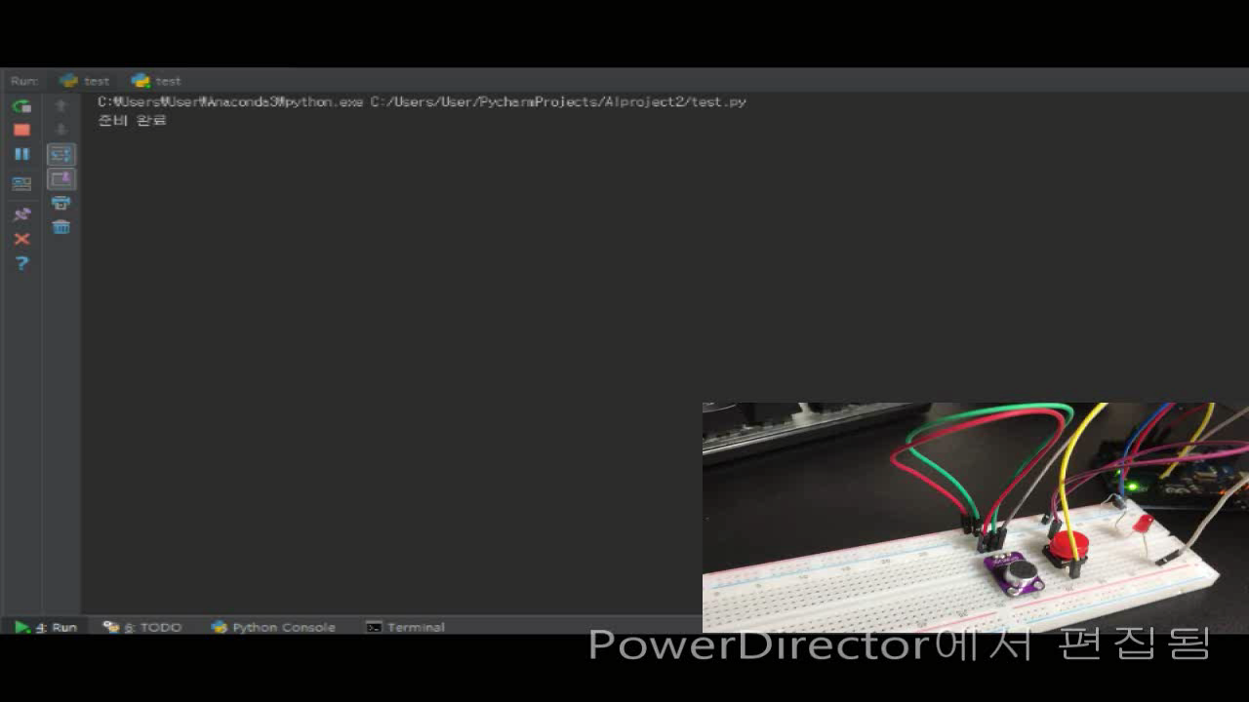
Result

Slide 27
Discussion
It was disappointing that there was a lot of difficulty in performing the speech analysis due to the performance of Arduino.
It was difficult to work without knowledge of sound.
It’s such a shame I do not have enough knowledge about the tensorflow.
It’s such a shame that I could not output to the Arduino speakers.
It was not very accurate, but it made me proud of making voice recognition.

Slide 28
Thanks to...
산업경영공학과 13학번 전한별
산업경영공학과 13학번 정종우
산업경영공학과 14학번 이전우
산업경영공학과 14학번 정기평
산업경영공학과 16학번 김가연

Slide 29
Thank You.

